Slide 1
Agentic AI Hackathon: Building Intelligent Agents with IBM Granite and LangFlow

Slide 2


Name of the team: CHARLES FLINT
Details of Team members
TEAM MEMBER NAME | Recent Passport Photo | Email ID | Phone number [WhatsApp]
BHASKAR S |  | bhaskarsnaidu8776@gmail.com | 9663949447
G DAEWOO SRI PRASAD |  | daewoosriprasadg@gmail.com | 9113589606

Slide 3
Problem statement
AI-Assisted Yield Trend Analysis and Farm Planning System
Understanding yield variability across seasons is essential for improving farm productivity. However, historical yield data combined with environmental and management factors is often underutilized due to analytical complexity. An intelligent AI system is required to analyze yield trends and identify contributing factors

Slide 4
Proposed solution
An Agentic AI System built using Langflow and IBM Granite that:
• Analyzes historical yield and farm data
• Detects trends and correlations
• Provides assistive farm planning insights
• Uses naïve RAG with agricultural research

Slide 5
Need of project
• To analyze historical crop yield data and identify important trends and patterns.
• To support data-driven farm planning using AI instead of manual analysis.
• To improve productivity and promote sustainable agricultural practices.

Slide 6
End user of project
• Farmers – To understand historical yield trends and make informed crop planning decisions.
• Agricultural Planners & Agronomists – To analyze yield patterns and recommend better farming practices based on data insights.
• Farm Management Organizations – To optimize resource usage and improve long-term productivity.
• Government & Agricultural Departments – To support policy planning, crop forecasting, and food security initiatives.
• Research Institutions – To study yield variability and evaluate the impact of environmental and management factors.

Slide 7
Technology Used
Langflow platform
Langflow component name – Chat Input, IBM Watsonx AI Agent, Chat Output
IBM Grainte model - for eg – ibm-granite-3-2-8b
IBM Cloud
IBM Watsonx.ai
Watsonx

Slide 8
Novelty and Uniqueness
• Uses AI agents to analyze crop yield data instead of manual methods.
• Combines historical yield, weather, and soil data for better insights.
• Provides simple, explainable planning suggestions using IBM Granite.

Slide 9
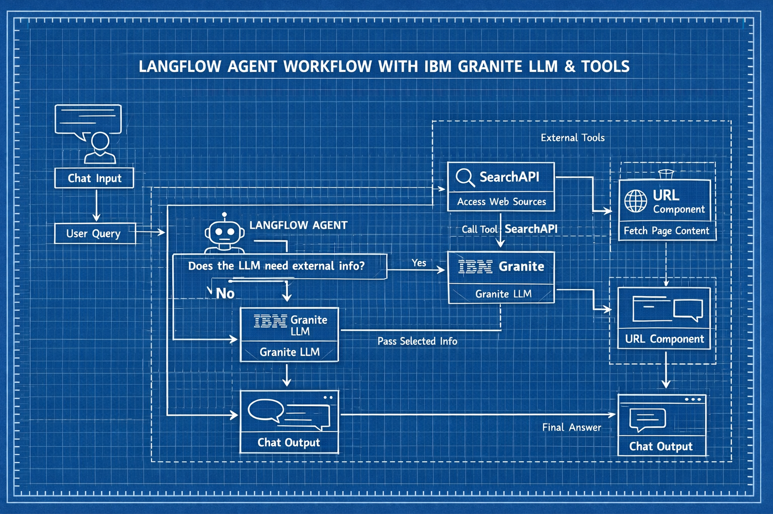
Technical flow diagram - Architecture blueprint

Slide 10
Langflow component Used
• Chat Input : Collects crop, yield, weather, and soil details from the user..
• IBM Watsonx AI Agent (Granite Model): Analyzes data, detects trends, and generates planning insights.
• Chat Output: Displays yield trends, correlations, and farm planning suggestions.

Slide 11
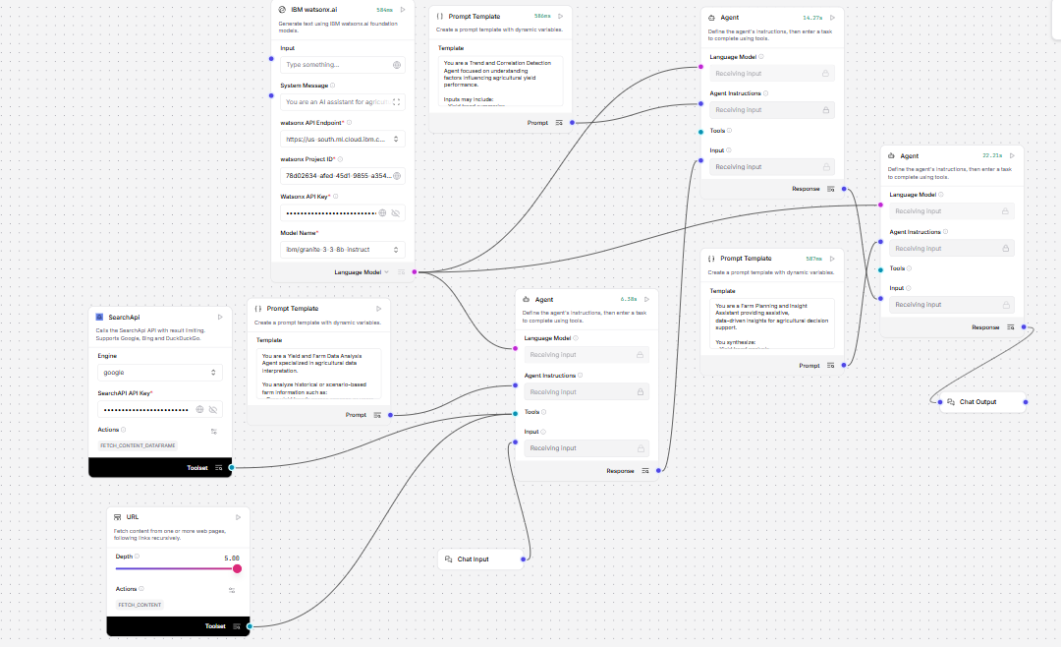
Input Screenshot 1

Slide 12
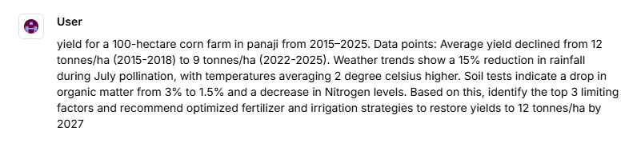
Input Screenshot 2

Slide 13
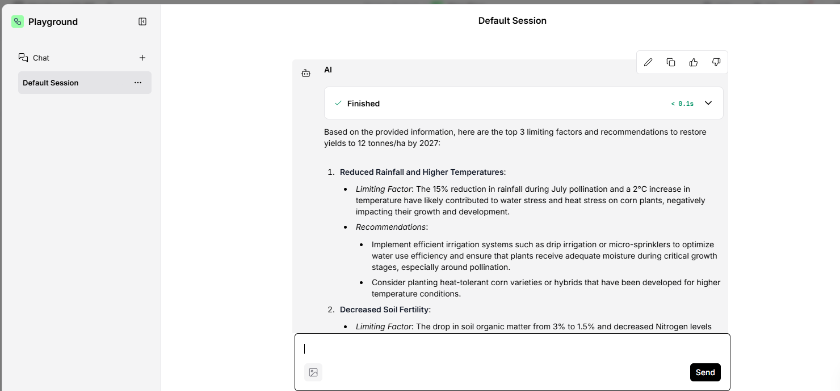
Output Screenshot 1

Slide 14
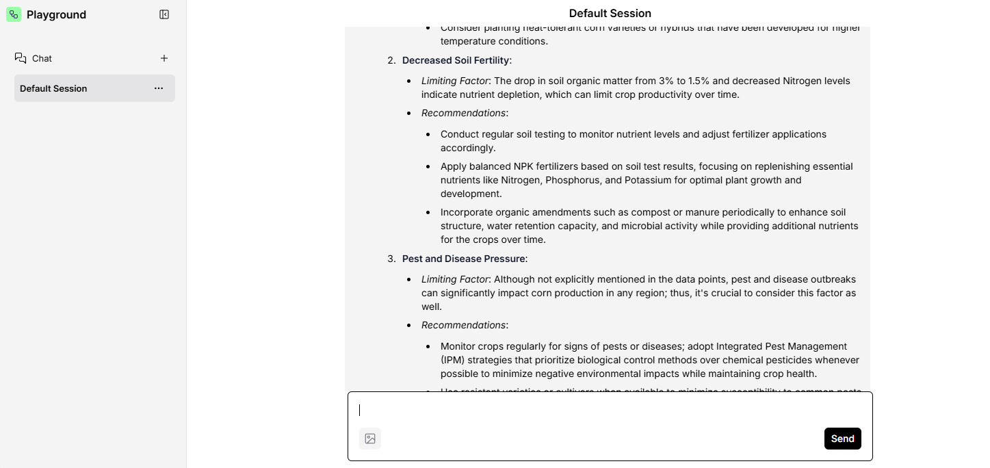
Output Screenshot 2

Slide 15
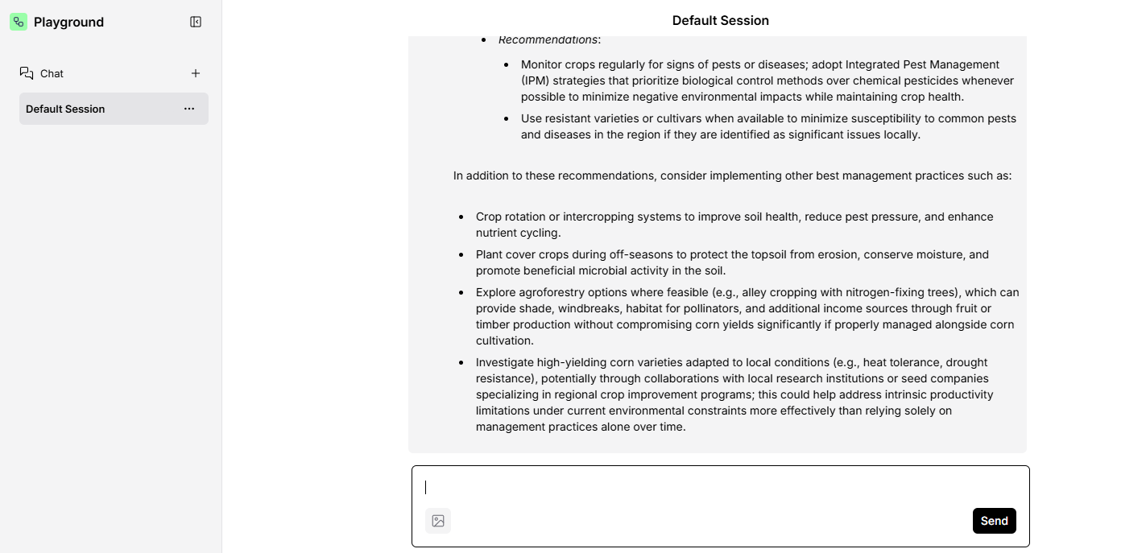
Output Screenshot 3

Slide 16
Future Scope
1. Advanced RAG with Vector Databases
Integrating vector databases (FAISS, Pinecone, Milvus) enables semantic search over internal documents along with web data, improving accuracy and contextual relevance
2. Multi-Agent Collaboration
Multiple specialized agents (research, verification, summarization) can work together to improve reasoning quality, reduce errors, and handle complex tasks efficiently.
3. Tool Ranking and Source Trust Scoring
Future systems can automatically rank and prioritize tools and sources based on credibility, recency, and relevance, increasing reliability of responses.
4. Autonomous Tool Invocation
Agents can independently decide how many times to search, which URLs to open, and when to stop, leading to semi-autonomous AI workflows.
5. Multimodal Information Processing
Extending support to PDFs, images, tables, and code repositories allows the system to handle diverse enterprise data formats.
·
·
·

Slide 17
Git Hub Link
· Please create public github repository (Enable Add README button while creating repository) with format –
Please test and Paste the working Github URL – https://github.com/bhaskars-17/charlie-flint.git
Make sure you have Uploaded following three files into your github repository
1) langflow json file , 2) your_hackthon_problemstatement.pdf file 3) your projectpresntation.pptx file
·
·
·

Slide 18
References
Langflow Documentation
Langflow Contributors. Langflow: A Visual Framework for Building LLM Applications.
https://docs.langflow.org/
IBM watsonx.ai Foundation Models
IBM. watsonx.ai: Enterprise AI and Foundation Models.
https://www.ibm.com/products/watsonx-ai
LangChain Framework
LangChain. LangChain: Building Applications with LLMs.
https://www.langchain.com/
·
·
·

Slide 19


